Slide 1
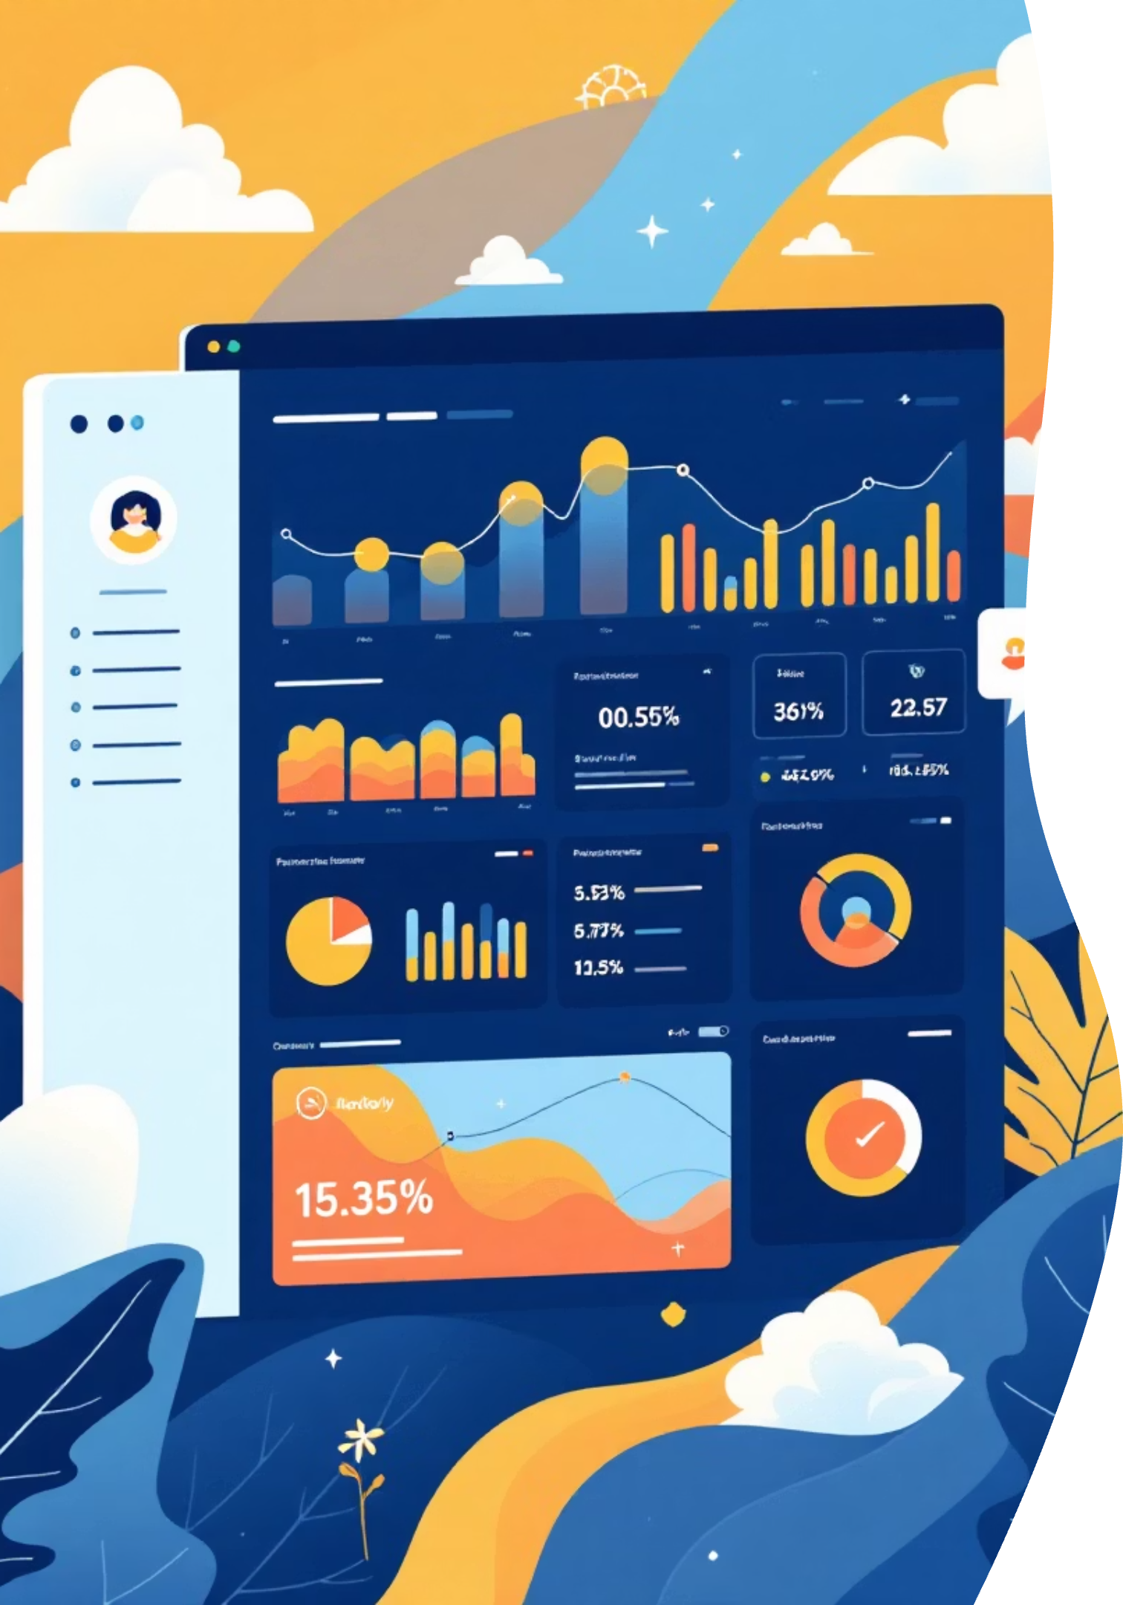
GenAI-Powered Promotion Insights Assistant
Transforming promotional planning through intelligent data extraction and AI-driven recommendations
Team Synapse Squad
• Rajib Nayek • Arghya Sinha Roy • Samaita Sarkar
• Dwijo Ganguly • Oyshi Roy

Slide 2
The Challenge: Fragmented Promotional Intelligence
Current State Problems
Business Impact
Promotional insights scattered across unstructured sources—reports, presentations, emails, and spreadsheets
Delayed decision-making for time-sensitive promotions
Missed opportunities for high-performing product categories
Manual analysis is time-intensive, inconsistent, and error-prone
Inconsistent promotional strategies across teams
Suboptimal resource allocation and campaign planning
Difficulty identifying patterns across historical campaigns
Limited visibility into what drives promotional success

Slide 3
Real Business Scenarios
1
2
3
Holiday Campaign Analysis
Product Bundle Optimization
Customer Segment Targeting
Marketing team needs to analyze Black Friday performance across 50+ product categories from last three years. Manual extraction from reports takes 2 weeks—too slow for planning.
Identifying which product combinations drove highest uplift requires correlating data from CRM, sales reports, and customer feedback—currently a manual, 40-hour process.
Determining which customer segments respond best to specific promotion types involves reviewing scattered engagement data, purchase patterns, and retention metrics across multiple systems.

Slide 4
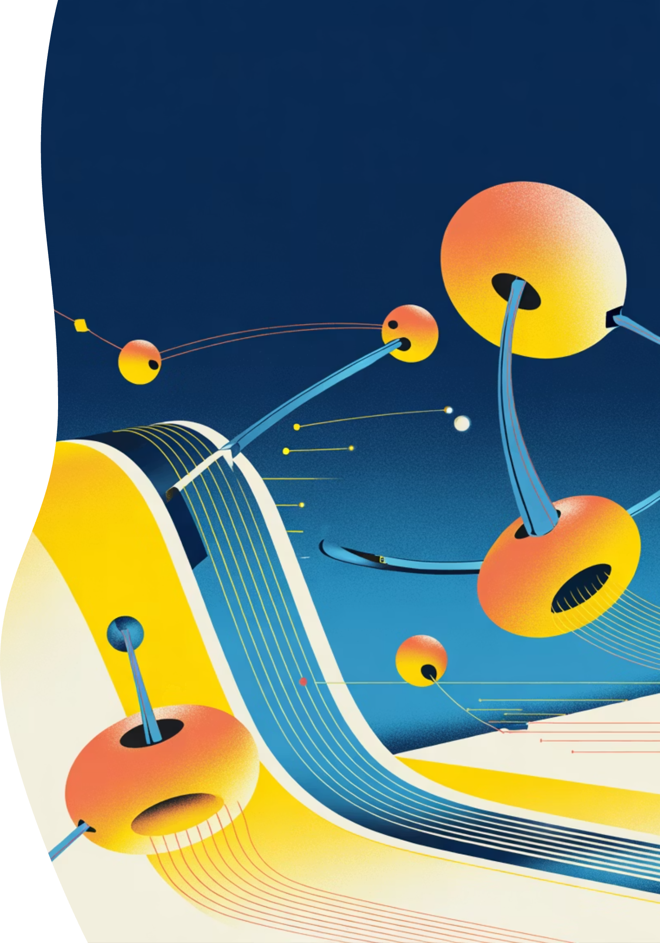




Our Solution: AI-Powered Promotion Intelligence
A GenAI-powered platform that automates promotional insight extraction, pattern recognition, and strategic recommendations—transforming weeks of manual work into minutes of intelligent analysis.
Automated Extraction
Pulls insights from reports, presentations, and unstructured data sources
Pattern Recognition
Identifies success factors and failure patterns across historical campaigns
Smart Recommendations
Generates data-backed strategies for future promotions and customer targeting
Conversational Q&A
Intuitive exploration of promotional data through natural language queries

Slide 5
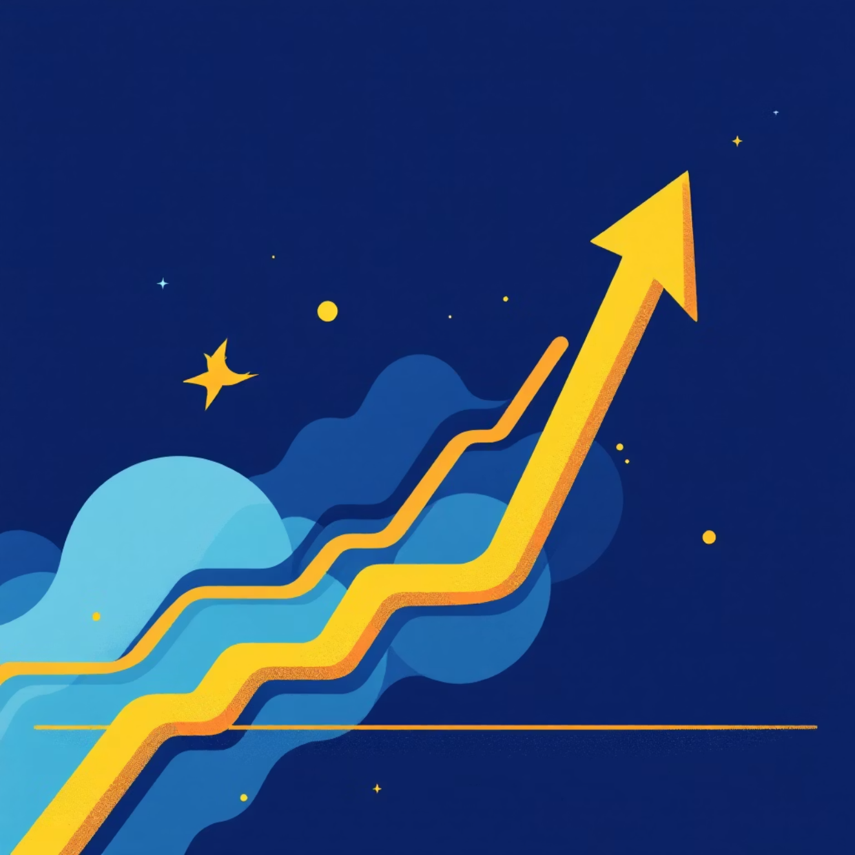
Measurable Business Benefits
85%
3x
Time Reduction
Faster Insights
Decrease in manual analysis effort for promotional planning
Speed improvement in extracting actionable intelligence from historical data
40%
$2M+
Better Accuracy
ROI Impact
Improvement in promotional strategy precision through AI-driven pattern recognition
Estimated annual value from optimized promotional planning and execution
By automating insight generation and providing data-backed recommendations, teams can focus on strategic decision-making rather than manual data compilation.

Slide 6
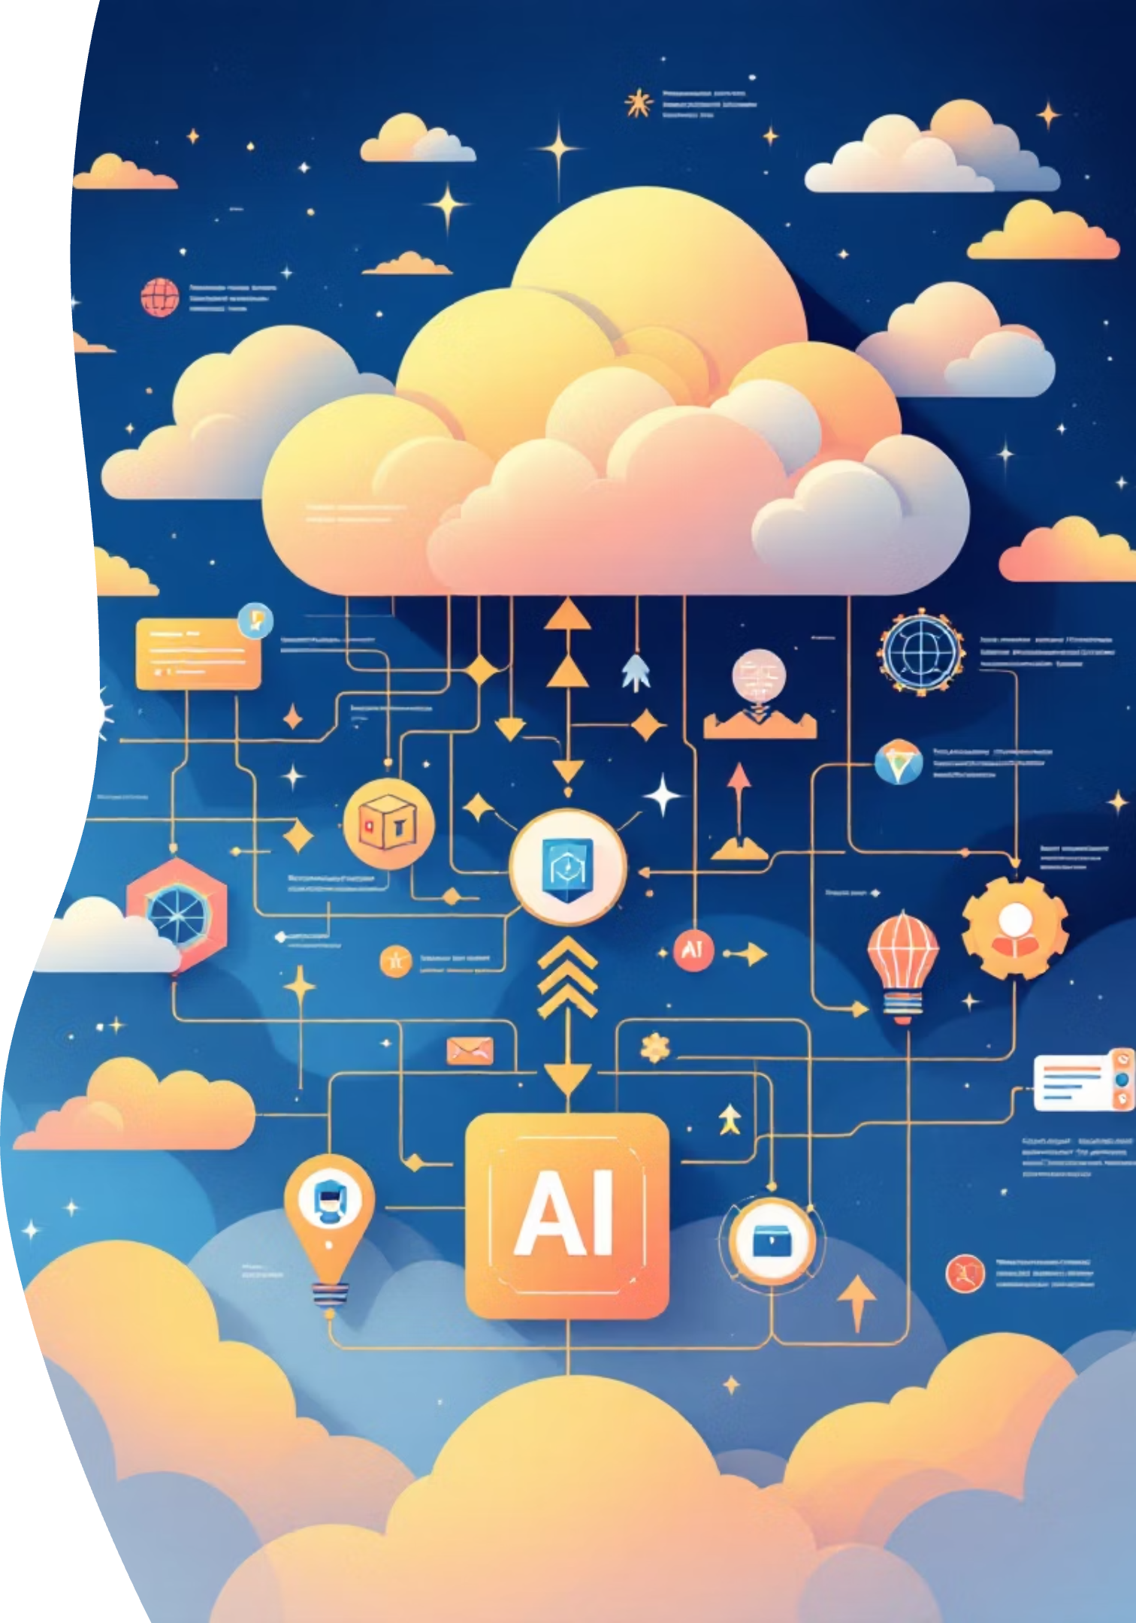
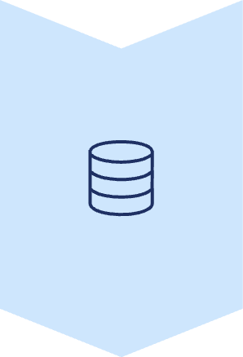


Solution Architecture: Overview
Data Ingestion Layer
Extracts promotional data from reports, presentations, spreadsheets, emails, and structured databases
GenAI Processing Engine
LLM-powered extraction, summarization, pattern recognition, and recommendation generation
User Interface
Conversational Q&A interface, dashboards, and insight visualization for stakeholders

Slide 7

Data Ingestion and Graph Retrieval-Augmented Generation (GraphRAG) pipeline
Data Ingestion Agentic using Lang Graph, UI to Easy Data Ingestion.
CSV Ingestion Agent
Data Sources
Planner Node
PPT Ingestion Agent
Chunk
Ingestion
Doc Ingestion Agent
Neo4j
Admin Persona
Text Ingestion Agent
Image Ingestion Agent
Trans Factor
Summarize
Ingestion
Multilingual
Uniqueness-> Every Node is a "every node is a semantic node". [Both Graph Traversal & Semantic Search]
Agent Pipeline
Intent Analysis
Semantic search +
Graph Traversal
(Based on Intent)
LLM Summarize
Output
Prompt
User Persona
Graph export as PDF
KPIs-> Agent performance KPIs – Latency, Cost/ PCI Transition

Slide 8

Technical Architecture: Deep Dive
01
02
Data Sources & Connectors
Data Processing & Vectorization
API integrations with CRM, ERP, document management systems; OCR for scanned reports; structured data pipelines from sales and customer databases
Document parsing, chunking, embedding generation using state-of-the-art models; vector database storage for semantic search and retrieval
03
04
GenAI Agent Framework
Output & Orchestration
Multi-agent orchestration with specialized agents for extraction, analysis, recommendation, and Q&A; RAG (Retrieval-Augmented Generation) for grounded responses
RESTful APIs, real-time dashboards, automated report generation; integration with existing workflow tools and notification systems
Built on scalable cloud infrastructure with enterprise-grade security and compliance

Slide 9
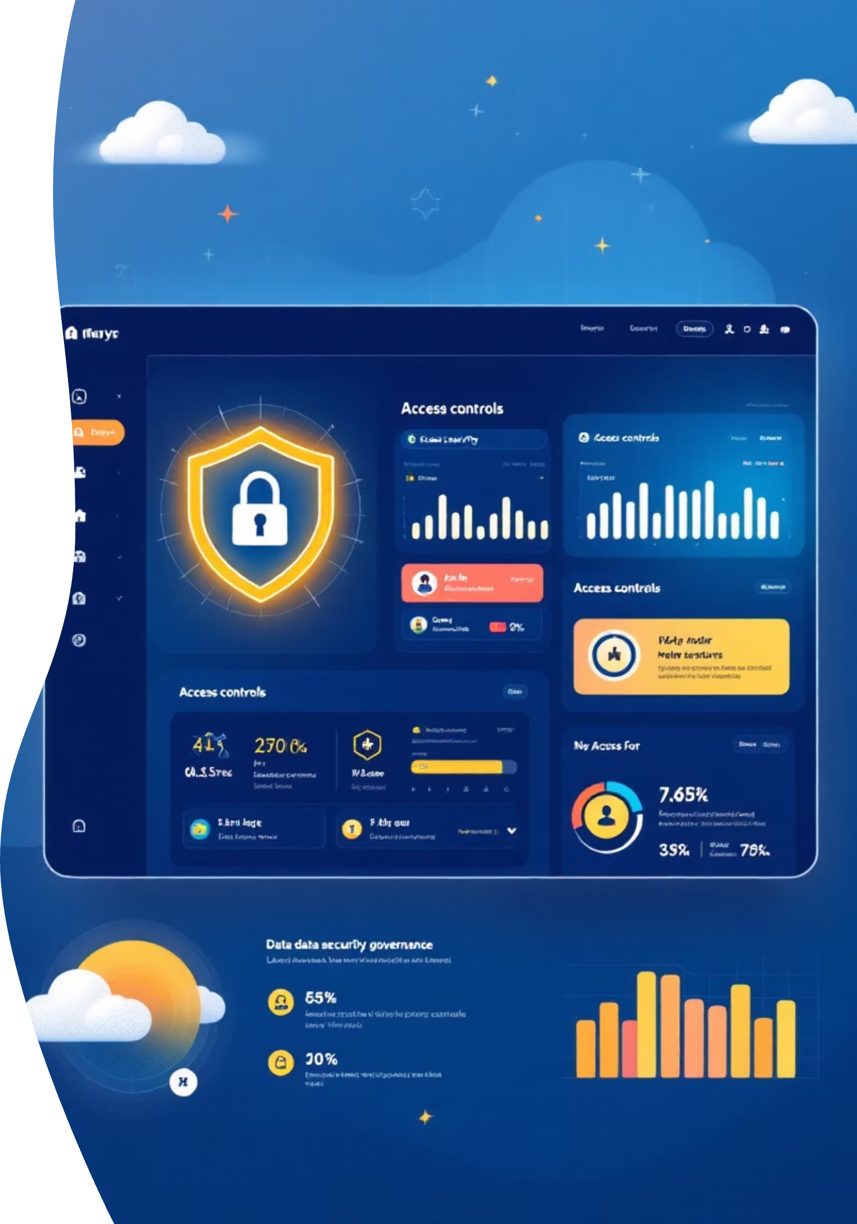
Data Sources & Control Framework
Extract Sources
Governance & Control
Structured Data: Sales databases, CRM systems, promotional uplift tables, customer transaction logs
Access Control: Role-based permissions ensuring data privacy and compliance
Unstructured Data: PDF reports, PowerPoint presentations, email threads, product descriptions
Data Quality: Automated validation, deduplication, and consistency checks
Semi-Structured Data: CSV exports, Excel spreadsheets, JSON logs from digital campaigns
Audit Trail: Complete logging of data access, processing, and AI-generated insights
Behavioral Data: Customer engagement metrics, retention patterns, purchase frequency
Synthetic Data: Generation capabilities for testing and model training without exposing sensitive information

Slide 10
Platform Capabilities Demonstration
Conversational Insights
Performance Summaries
Strategic Recommendations
Ask natural language questions like "Which products had highest uplift in Q4 promotions?" and receive instant, data-backed answers
Automated extraction and visualization of key metrics across product categories and customer segments
AI-generated suggestions for product bundling, timing optimization, and targeted customer segmentation

Slide 11
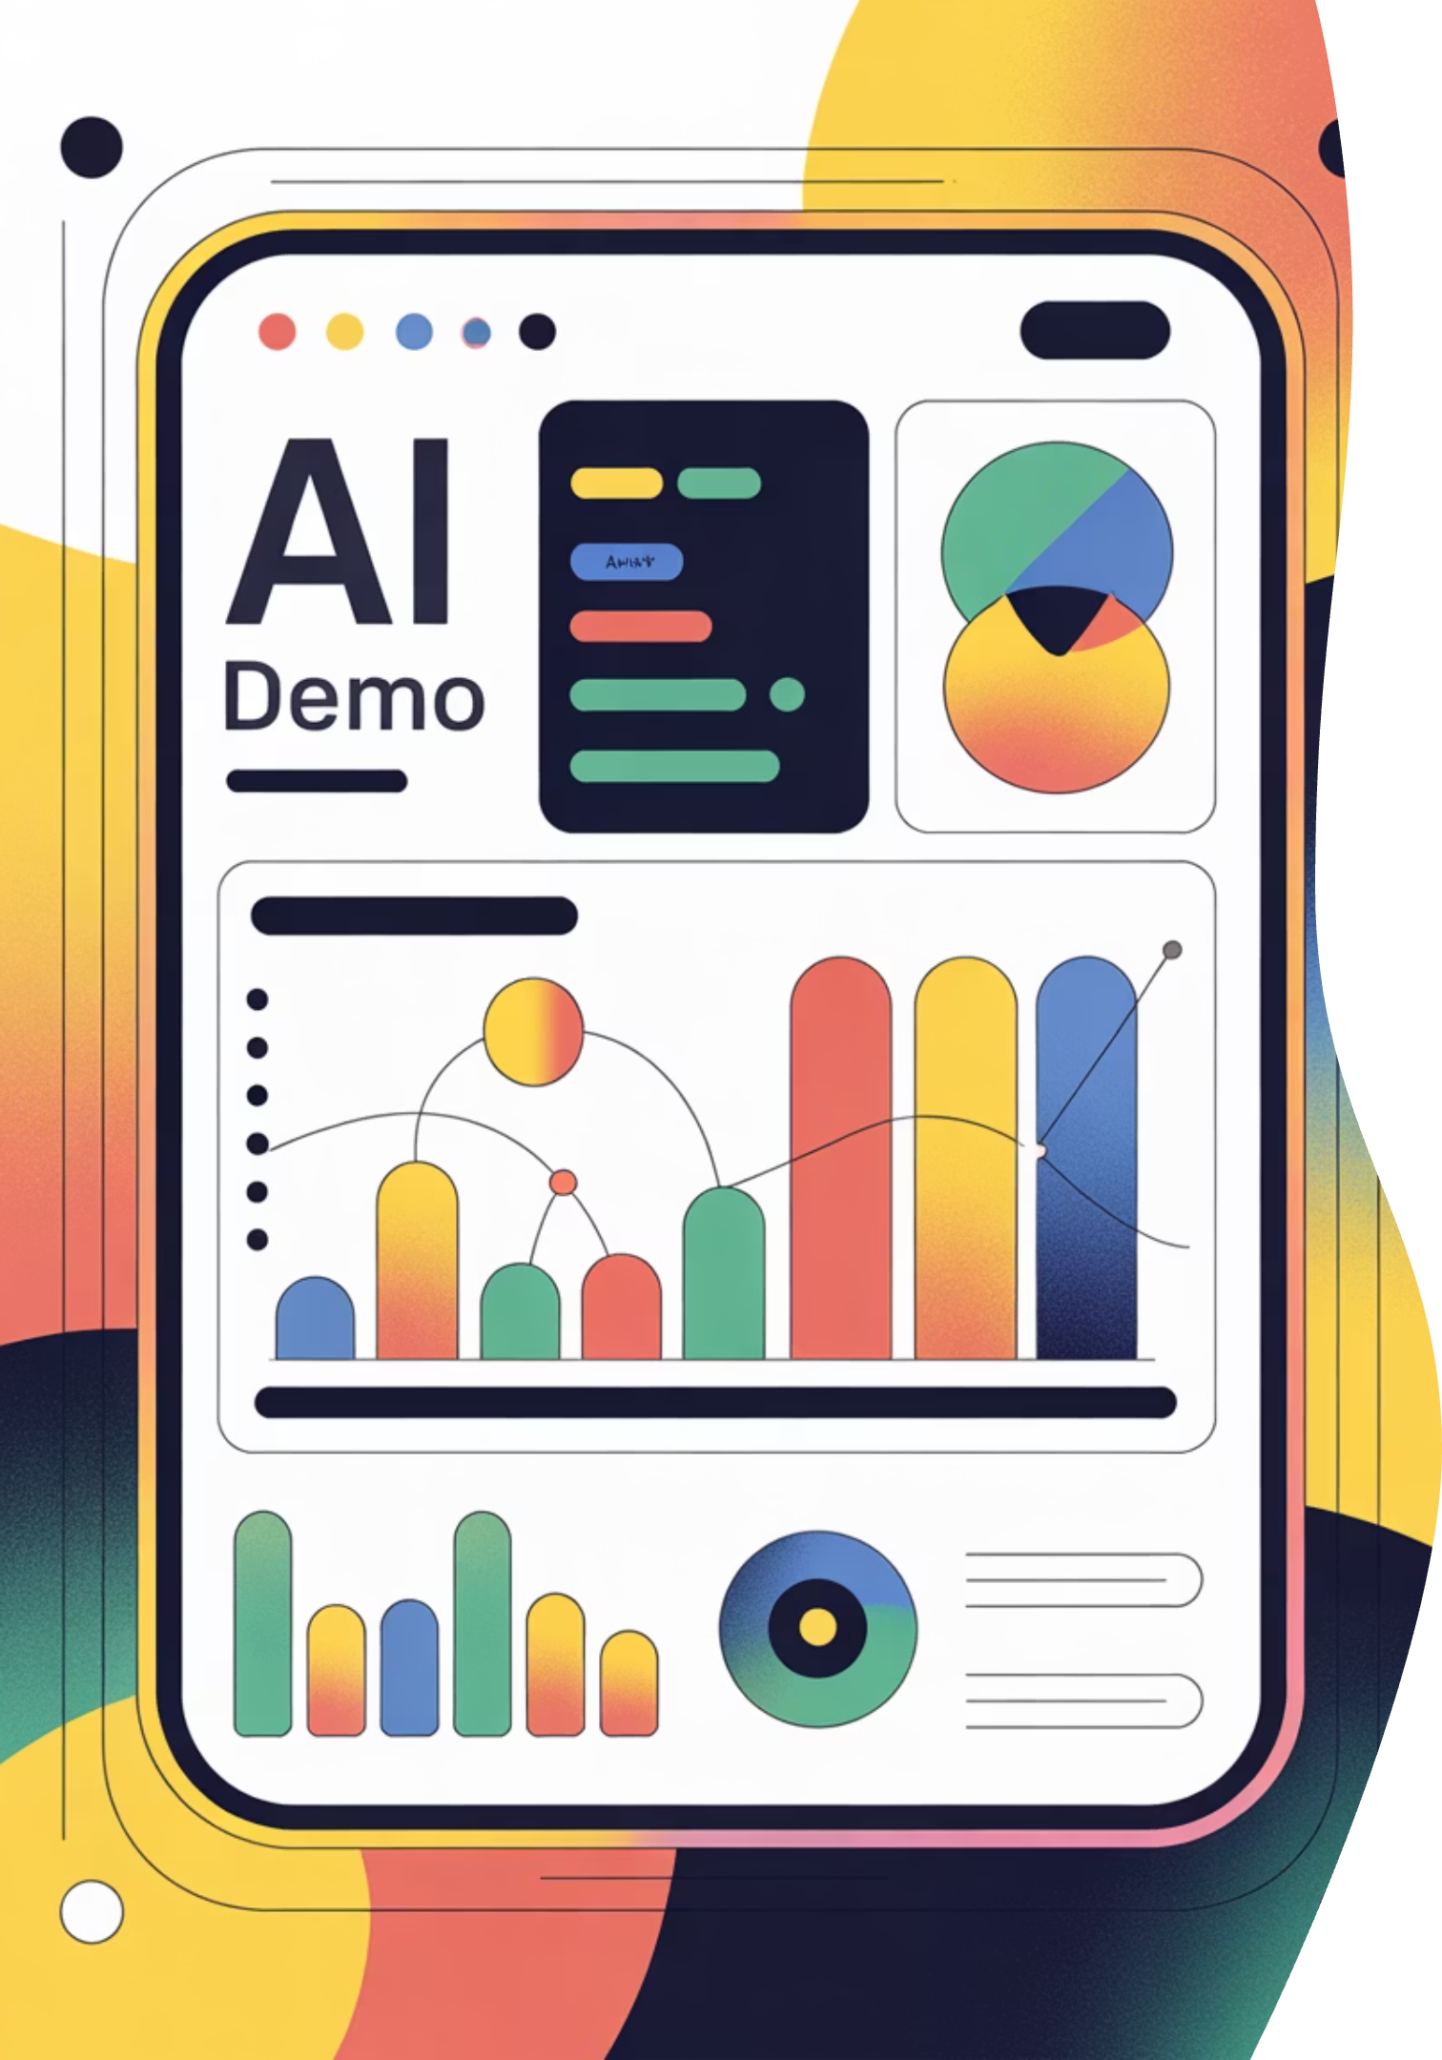
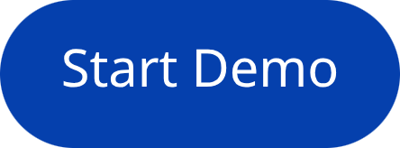

Live Agent Demo
Watch our GenAI Promotion Insights Assistant in action as we demonstrate real-time insight extraction, pattern analysis, and intelligent recommendations from historical promotional data.
Team Synapse Squad • Ready to transform your promotional intelligence

